Slide 1
Sprint 6 – Intro to Backend
June 24 – June 29 (2025)

Slide 2
Master Schedule (Day #2 - 6/12)
Today 6/12

Slide 3
Agenda – 6/28 Saturday
Completed stat card system + task table integration
Feature development
Unit + integration tests
Documented pull requests + code reviews
Started working on backlog items
1. Backend setup & integration
2. Database setup & integration

Slide 4
Previous Progress
Completed stat card system, will show gifs + live demo
Finished pull request to simulate real world development workflows/practices
Pull request: request made from a developer and sent to the project owner to integrate a standalone feature with the main project storage location
Testing
Used vitest and react testing-library to create a test for every subcomponent
Error management/handling for props
Integration tests for all subcomponents working in the larger TaskTable component, same for the stat card system, then wrote tests for the subsystems working together
Started setting up database + backend
Completely changed database platform from MongoDB (NoSQL) to Supabase (SQL)
Cleaned + inserted relevant data records into cloud hosted db on Supabase needed for predictions and storing planned tasks
Created an ER diagram used to create tables on supabase

Slide 5
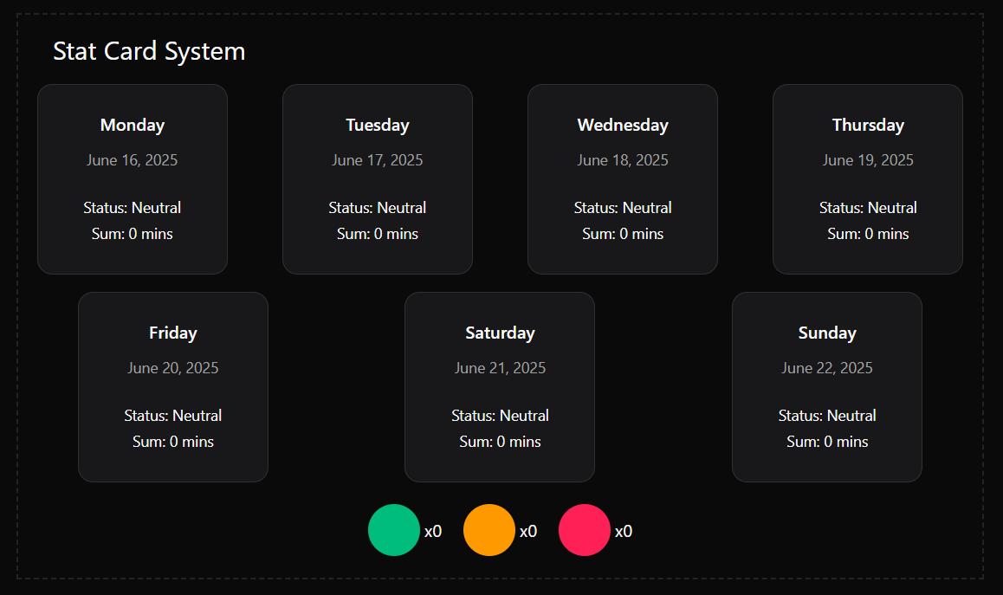
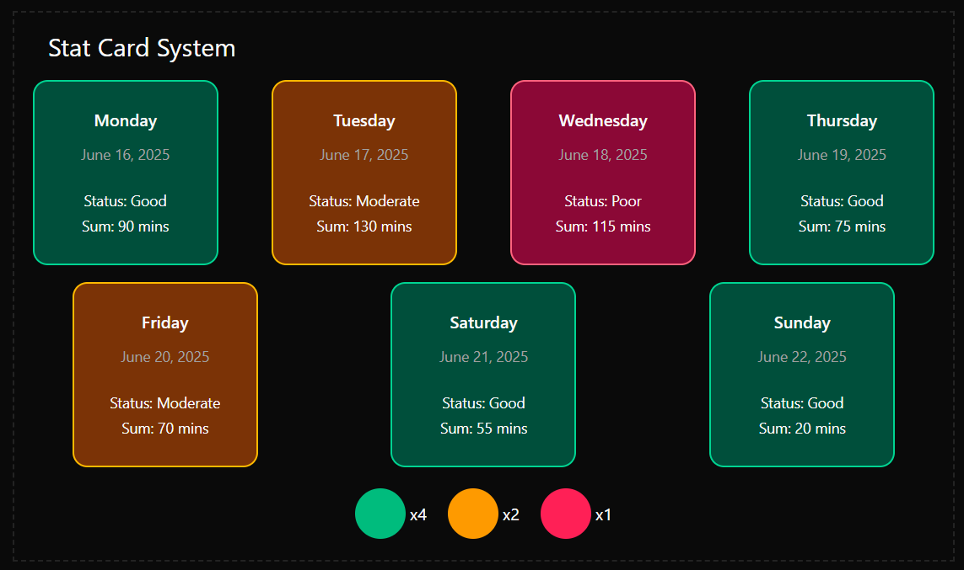
Previous Progress – Stat Card System

Slide 6
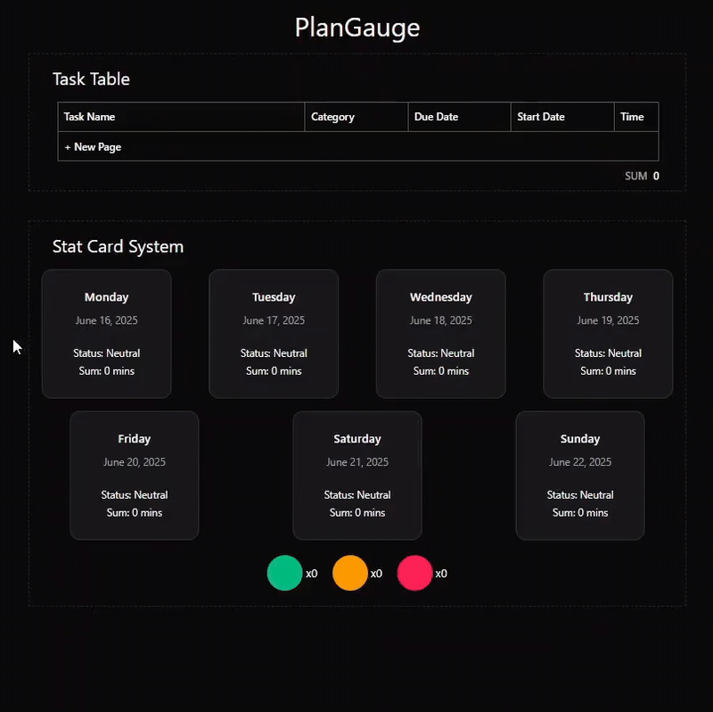

Slide 7
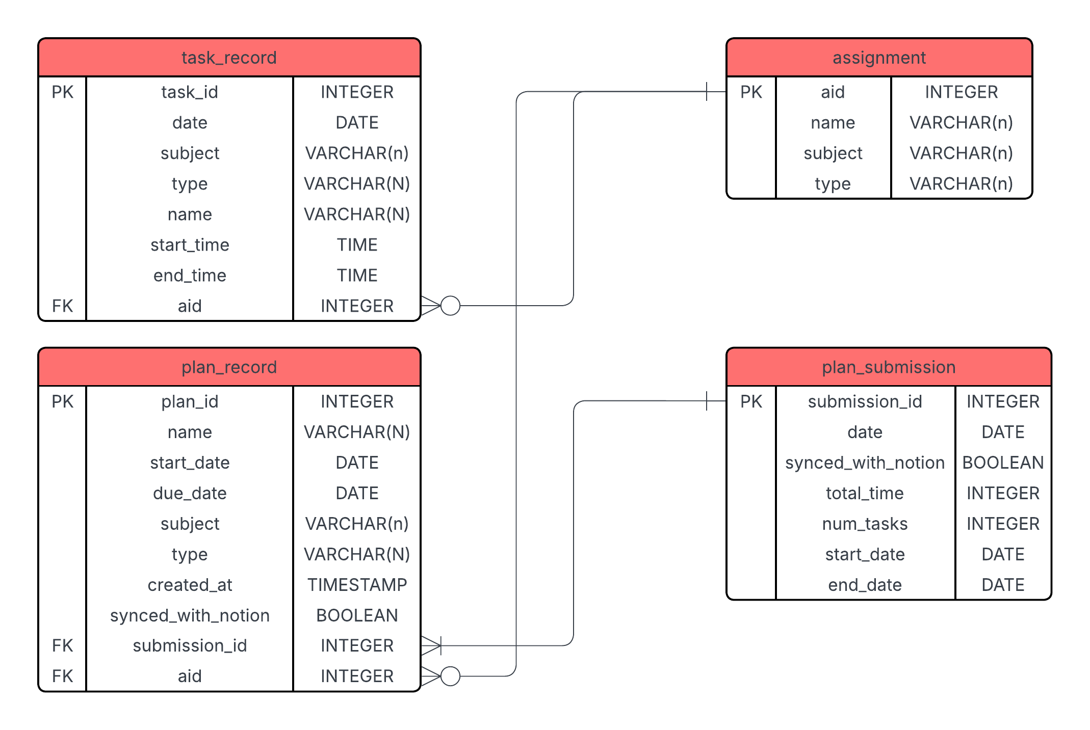
ERD

Slide 8
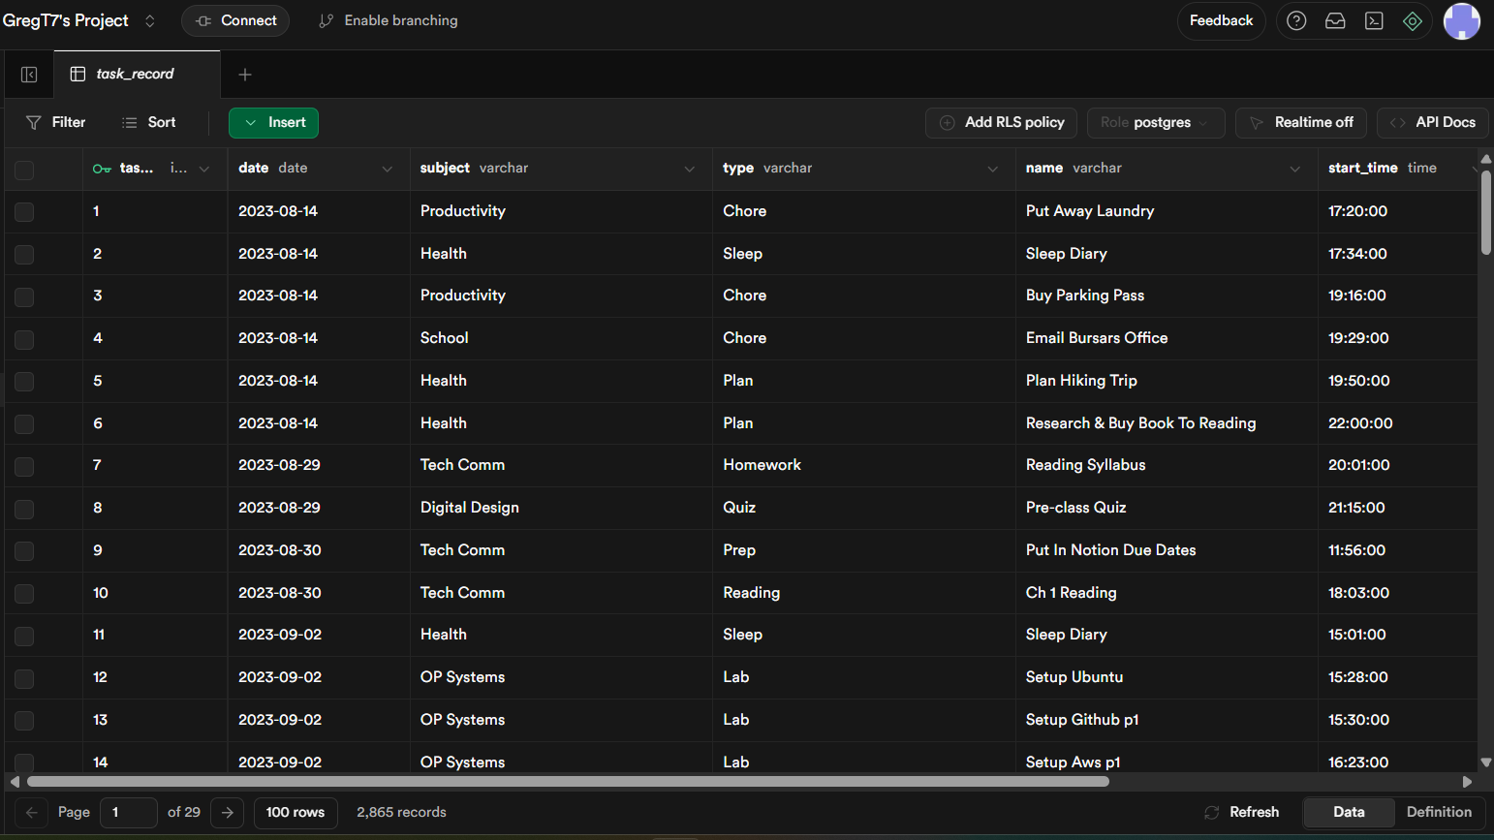
Supabase (Cloud hosted database)

Slide 9
Problems & Blockers
Taking a long time to learn about flask setup
Need to decide on how to integrate frontend server + backend servers at some point
Need to iron out subtasks for (1) Backend setup + integration (2) Database setup + integration
Need to decide on if I will add a quiz/learning item to the backend or database backlog item

Slide 10
Pending Actions
Setup flask application

Slide 11
Next Steps
Iron out backlog subtasks in Notion
Decide on incorporating a quiz for the backend
Ensure the subtasks account for integrating the backend to the frontend and not just internal backend integrations (flask to the database)
Continue learning how to create a basic flask application

